Slide 1


Slide 2

Unified University Management & Student Support Platform
Pre-Final Year Project Synopsis
Submitted by
Roll Number | Name
2301010289 | Vaibhav Vaid
2301010282 | Adeela Azeez
2301010300 | Himani Tyagi
2301010293 | Ashutosh Singh
2301010298 | Satdev
Faculty Mentor: Ms. Iflah Aijaz
Notes:
New Courses replaced with New Programmes

Slide 3

Project Overview
Universities usually manage academics, student support, and administrative work using different systems or manual methods. Students often need to check notice boards, emails, or visit offices personally to get information about attendance, exams, results, or grievances. This makes the process slow and confusing for both students and staff.
The Unified University Management & Student Support Platform is developed to solve this problem by providing a single web-based system for all university-related activities. It brings students, faculty, and administrators onto one platform where academic information, requests, and communication can be managed easily.
The system reduces manual work, improves transparency, and ensures faster communication. By using role-based access, each user gets only the features relevant to them, making the platform simple, secure, and efficient for daily university operations.
Notes:
New Courses replaced with New Programmes

Slide 4
Specific Objectives
To develop a centralized digital platform for academic management.
To reduce manual and paper-based academic processes.
To improve communication between students, faculty, and administrators.
To ensure secure storage and retrieval of academic data.
To provide a scalable and user-friendly system
Notes:
New Courses replaced with New Programmes

Slide 5
Key Features
Centralized student and faculty databaseRole-based access (Student, Faculty, Admin)
Academic notices and announcements
Course and academic record management
Secure login and data handling
Web-based, easy-to-use interface
Notes:
New Courses replaced with New Programmes

Slide 6
Proposed System Improvements
Provides a centralized web-based platform integrating academic and student support services.
Ensures real-time access to attendance, examination records, results, and notifications.
Implements role-based access control (RBAC) for students, faculty, and administrators.
Enables online grievance submission and tracking, improving transparency.
Automates attendance management, marks entry, and report generation.
Reduces manual workload and improves operational efficiency.
Maintains a centralized and secure database for data consistency and integrity.
Uses secure authentication mechanisms (JWT) to protect sensitive information.
Notes:
New Courses replaced with New Programmes

Slide 7
Project Usecases & Scope
Use Cases for Students-
Secure login and user registration
Review and edit your personal profile.
Analyze both overall and subject-specific attendance.
View the schedule and exam results.
Receive notifications and announcements
File complaints and monitor their progress
Seek guidance and mentorship for your studies
Faculty Use Cases-
Secure faculty login
Monitor and supervise student attendance
Upload grades and internal marks
View student academic performance
Respond to student requests and grievances
Notes:
New Courses replaced with New Programmes

Slide 8
Project Usecases & Scope
Use Cases for Administrators:
Verification of safe administrators
Control roles and users
Make academic announcements and bulletins public.
Manage academic calendar
Monitor the grievance process
Create academic reports and attendance records.
Notes:
New Courses replaced with New Programmes

Slide 9
Data Requirements
The system will handle the following types of data:
Student data (ID, name, department, attendance, results)
Faculty data (ID, subjects handled, assigned students)
Attendance records
Examination and result data
Notifications and announcements
Grievance records and responses
User authentication and authorization data
Notes:
New Courses replaced with New Programmes

Slide 10
Resources Required
Software Resources
Frontend framework: React.js
Backend framework: Node.js with Express / Django
Database: MongoDB / PostgreSQL
Authentication: JWT
IDE: VS Code
Version Control: Git
Hardware Resources
Development system with minimum 8 GB RAM
Stable internet connectivity
Notes:
New Courses replaced with New Programmes

Slide 11
Methodology
Research and Analysis:
Study existing university management systems and identify challenges faced by students, faculty, and administrators in managing academic and administrative processes. Inputs will be gathered through discussions, observations, and analysis of current institutional workflows.
Requirement Specification:
Define detailed functional and non-functional requirements for the Student, Faculty, and Admin modules based on the identified academic and administrative needs.
Design and Prototyping:
Create system architecture diagrams, database schemas, and UI wireframes using tools such as Figma to visualize role-based dashboards and user interactions.
Development:
Implement the platform using modern front-end and back-end technologies. Secure authentication, role-based access control (RBAC), and scalable RESTful APIs will be developed to ensure data integrity and system security.
Testing and Validation:
Perform unit testing, integration testing, and usability testing to identify bugs, verify functionality, and validate system performance across all modules.
Deployment and Maintenance:
Deploy the application using local or containerized environments (Docker). The system will be maintained and refined based on testing outcomes and future academic requirements.
Notes:
New Courses replaced with New Programmes

Slide 12
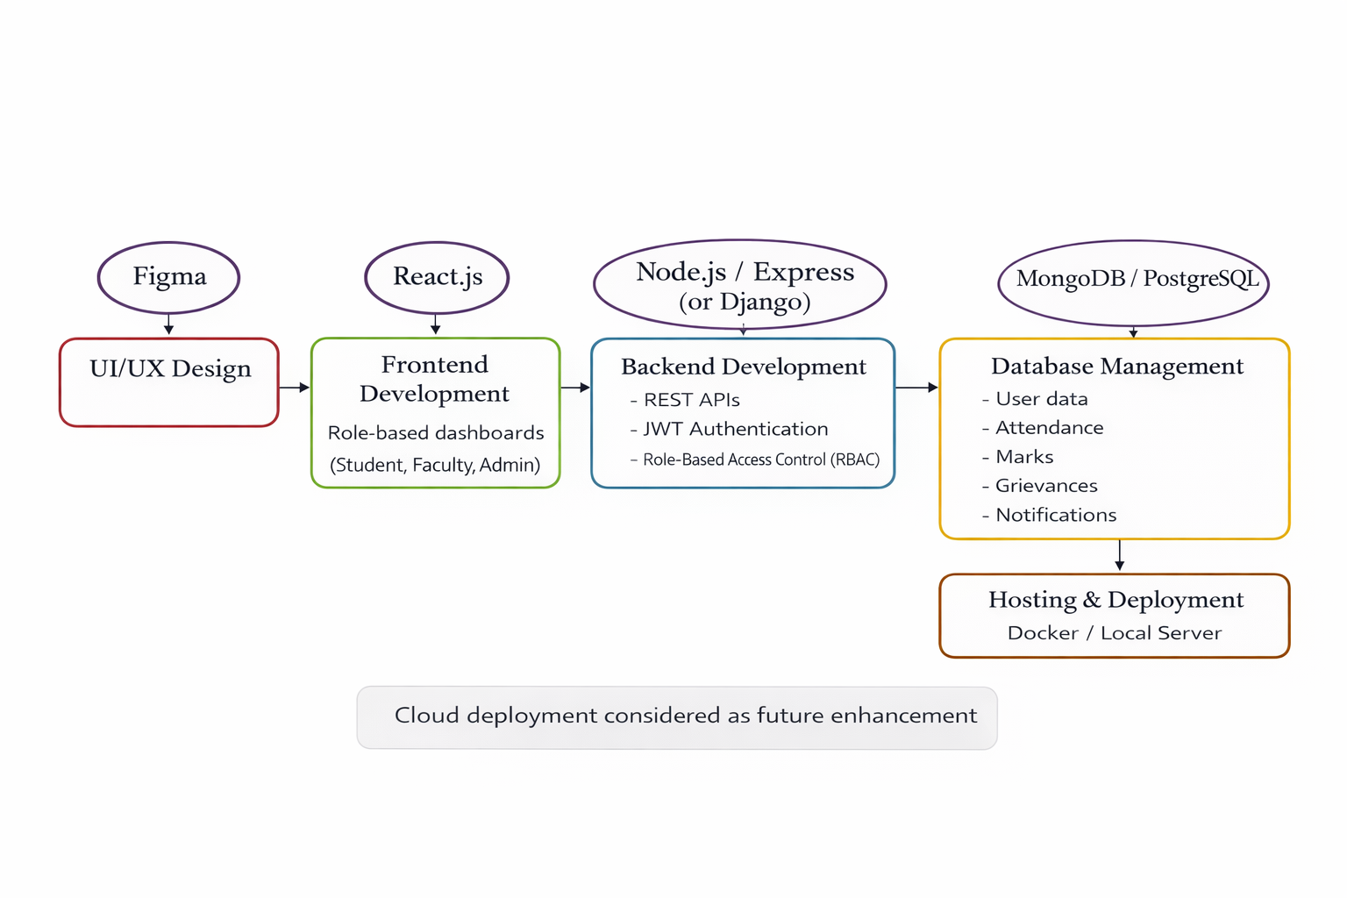
Methodology Flowchart
Notes:
New Courses replaced with New Programmes

Slide 13
Expected Results & Impact
Development of a centralized, secure, and role-based university management platform for students, faculty, and administrators.
Automation of academic and administrative processes such as attendance tracking, marks management, notifications, and grievance handling.
Reduction in manual workload and processing delays, leading to improved operational efficiency.
Enhanced transparency and accountability through real-time access to academic records and request status tracking.
Improved communication and engagement among students, faculty, and administration.
Accurate and reliable data availability supporting informed academic and administrative decision-making.
User-friendly and scalable system architecture that can support future enhancements with minimal cost.S
Notes:
New Courses replaced with New Programmes

Slide 14
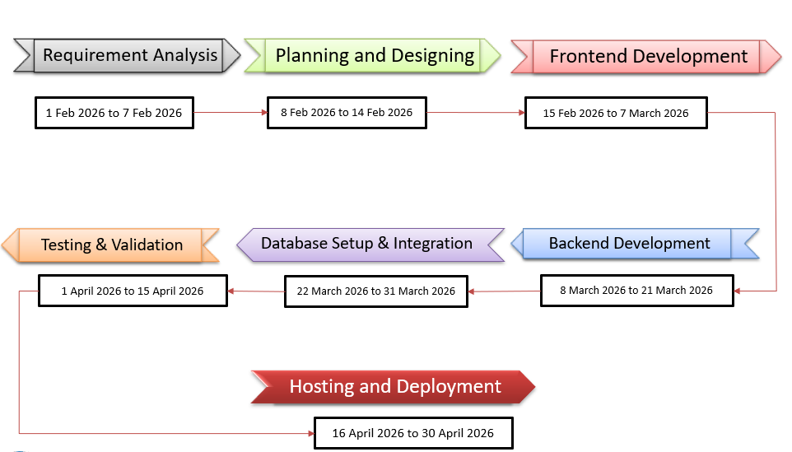
Project Timeline
Notes:
New Courses replaced with New Programmes

Slide 15
THANK YOU

